Slide 1

Student
Management System
A text-file-based student record system built in Python
Prasan Manandhar, Saksham Poudel, Shitansha Baral, Subigya Ghimire

Slide 2
Project Overview
A command-line Student Profile Management System that stores all data in plain text files. Admins manage records; students view their own data.
Login System
Username & password auth with 3-attempt limit
Admin Panel
Add, view, modify and delete any student record
Student Portal
Personal profile, grades, and ECA activities
Analytics
Matplotlib charts and pandas summary reports
File Storage
All data in .txt files no database

Slide 3
System Architecture
main.py
auth.py
admin.py
student_menu.py
Entry point & loop
Login & auth
Admin features
Student portal
student.py
file_handler.py
analytics.py
Student class / OOP
Read / write files
Charts
Data Files (.txt)
users.txt
passwords.txt
grades.txt
eca.txt
Modules import file_handler.py to access data no direct file I/O elsewhere

Slide 4
File Storage Format
users.txt
One user per line. Fields separated by commas.
U002, saksham, Saksham Poudel,saksham@school.com,student,2003-05-12
passwords.txt
Username and password per line.
saksham, subigya
grades.txt
Username followed by Subject:Score pairs.
saksham,Math:78,Science:85,English:72,Nepali:88,Computer:91
eca.txt
Username followed by Activity:Hours pairs.
saksham,Football:3,Debate Club:2,Photography:1

Slide 5


User Roles
Admin
Student
Add new users (admin or student)
View all users in the system
Modify any student's record
Delete any student and their data
View system-wide insights
Access the analytics dashboard
View their own full profile
View grades with pass/fail status
View ECA activities and hours
Update personal info (name, email, DOB)
Change their own password
Cannot access other students' data

Slide 6
OOP: The Student Class
Attributes
Methods
student_id
e.g. U002
get_average()
Mean score across all subjects
username
e.g. shitansha
get_grade_letter()
name
e.g. Shitansha Baral
Converts avg to A+, A, B+, B, C, D
email
e.g. shitansha@school.com
is_failing()
True if average is below 60
dob
e.g. 2003-05-12
get_total_eca_hours()
grades
dict {Math: 78, …}
Sum of all ECA hour values
display_profile()
eca
dict {Football: 3, …}
Prints full profile to terminal

Slide 7
Analytics Dashboard
Grade Trends
ECA vs Grades
Subject Breakdown
Bar chart of each student's average. Green = pass, Red = fail.
Scatter plot comparing total ECA hours against grade average.
Grouped bars showing every student's score per subject.
Performance Alerts
Pandas Summary
Lists failing students with suggested intervention actions.
Mean, min, max, std dev table + ECA grade correlation value.
All charts are saved as PNG files to the charts/ folder. Libraries: matplotlib, numpy, pandas.

Slide 8
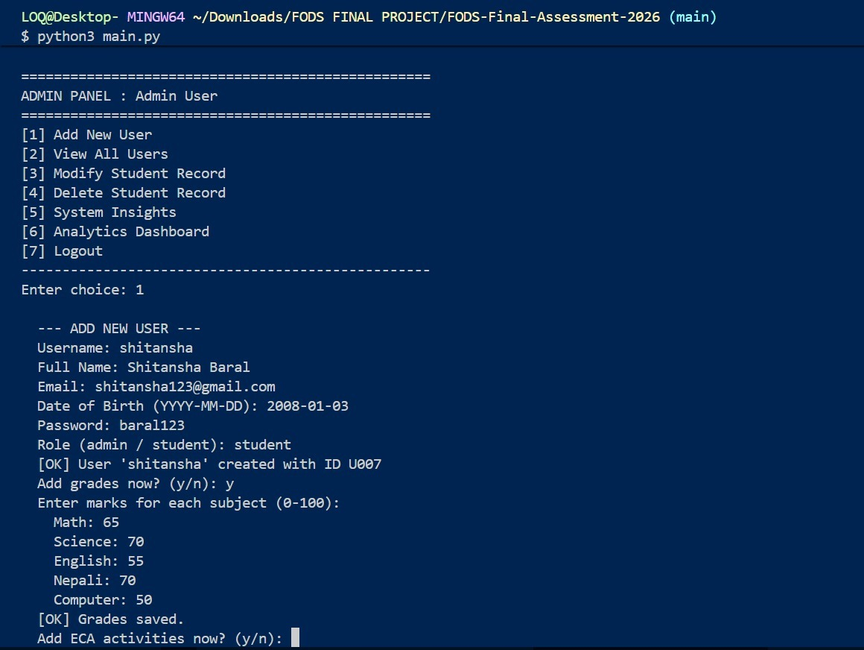
Sample Output

Slide 9
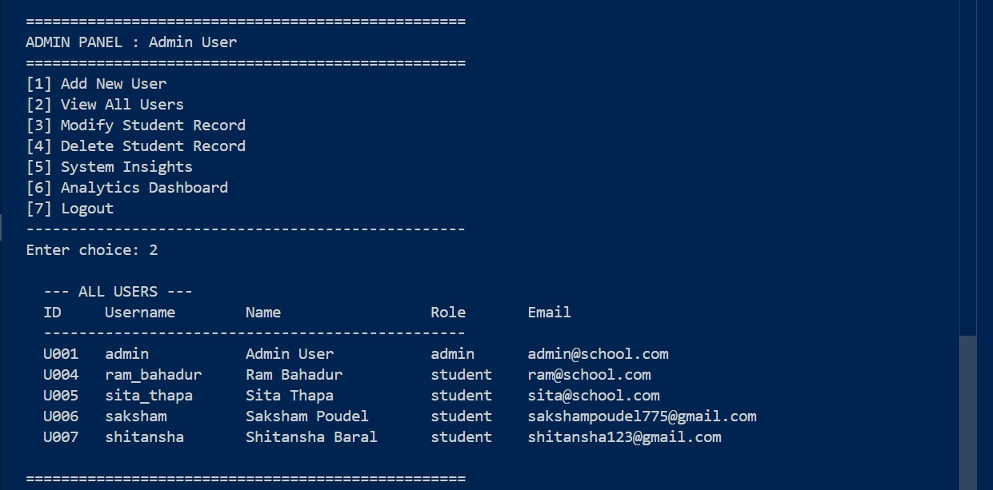
Sample Output

Slide 10
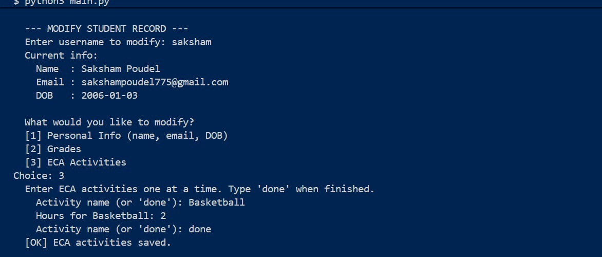
Sample Output

Slide 11
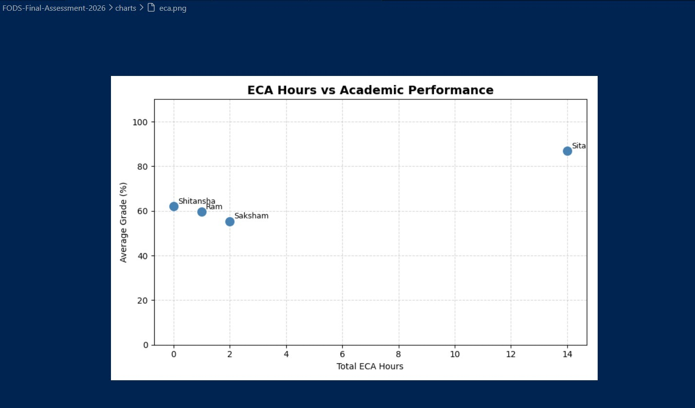
Sample Output

Slide 12
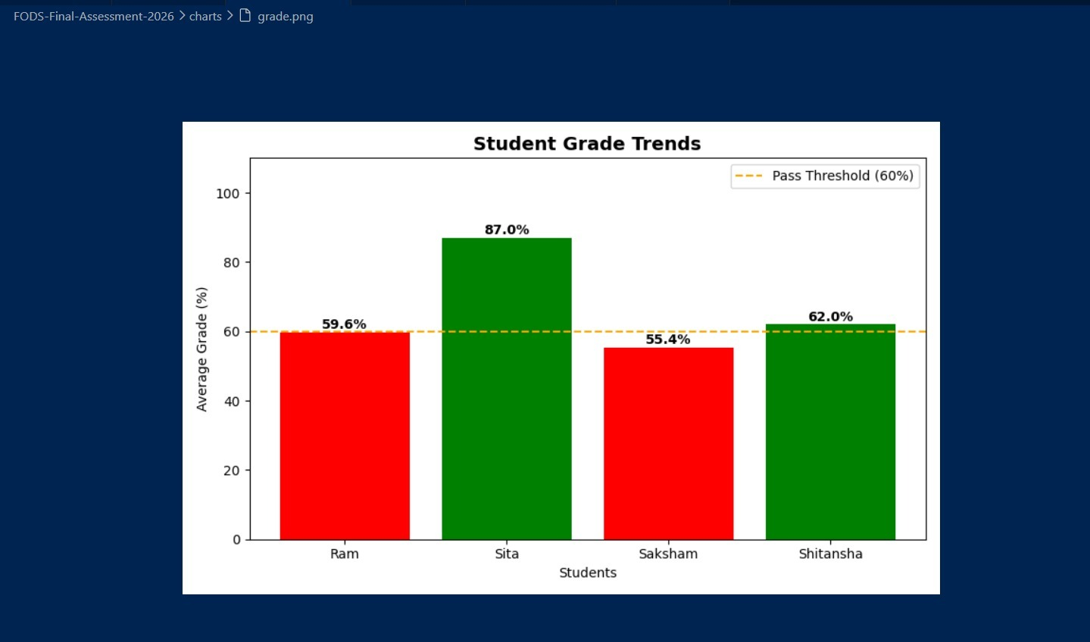
Sample Output

Slide 13
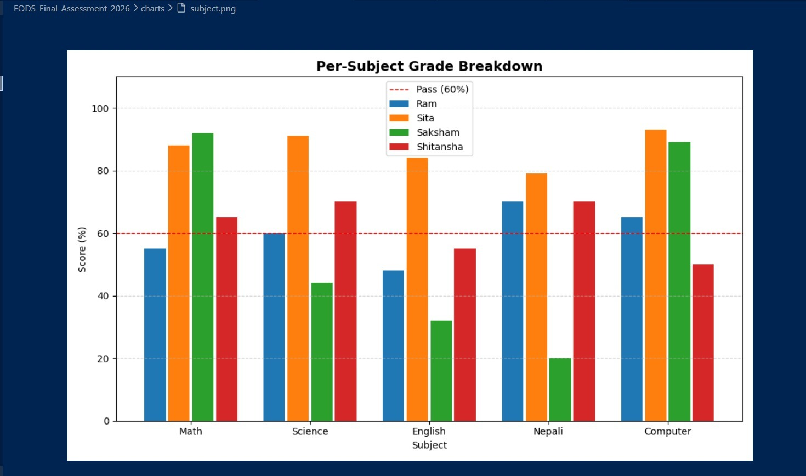
Sample Output

Slide 14
Thank You
We are happy to take you questions.
Run: python3 main.py

